Slide 1
LINUX UBUNTU

Slide 2
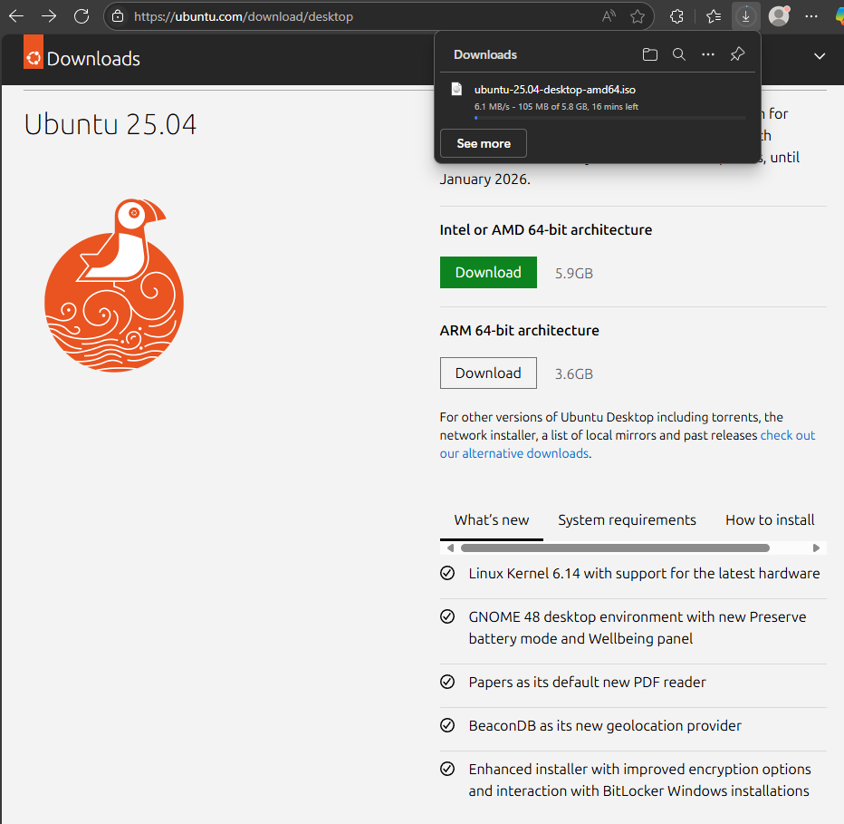
Download latest Ubuntu ISO image

Slide 3
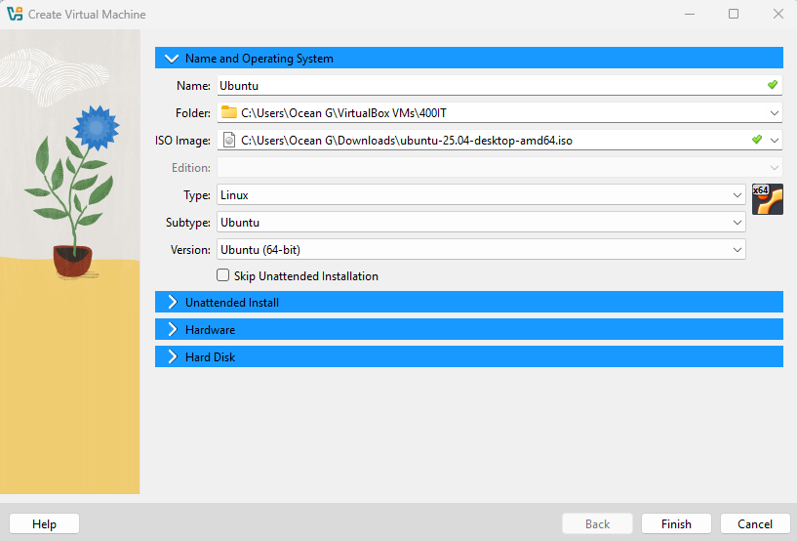
Begin setup for vm creation,
Name
Iso
File location

Slide 4
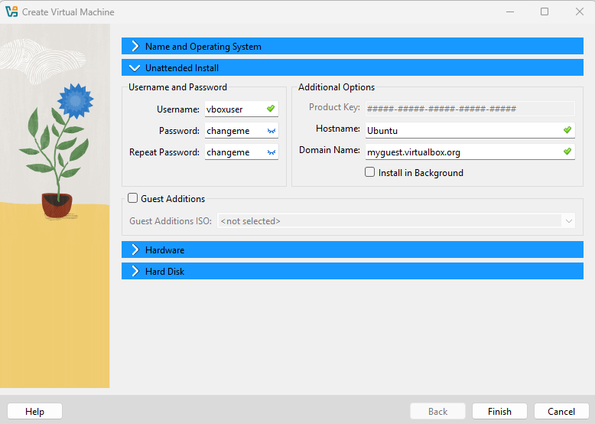
Set Password and user
Vboxuser
changeme

Slide 5
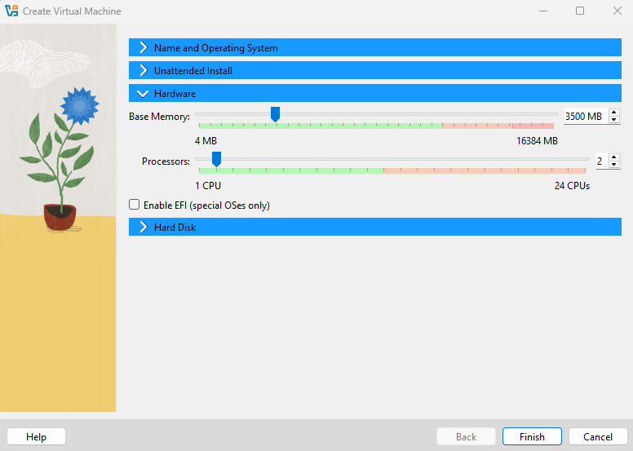
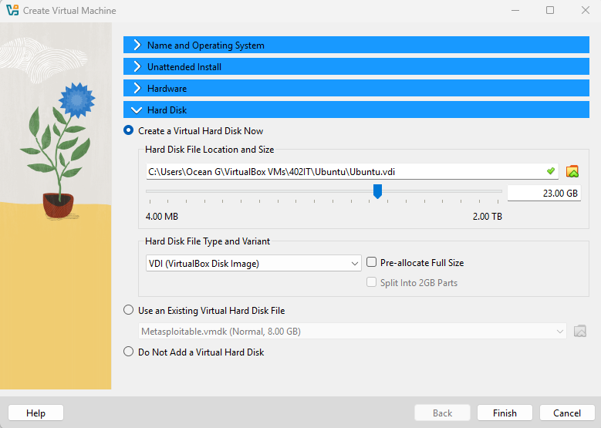
Defining resources
Finish creation

Slide 6
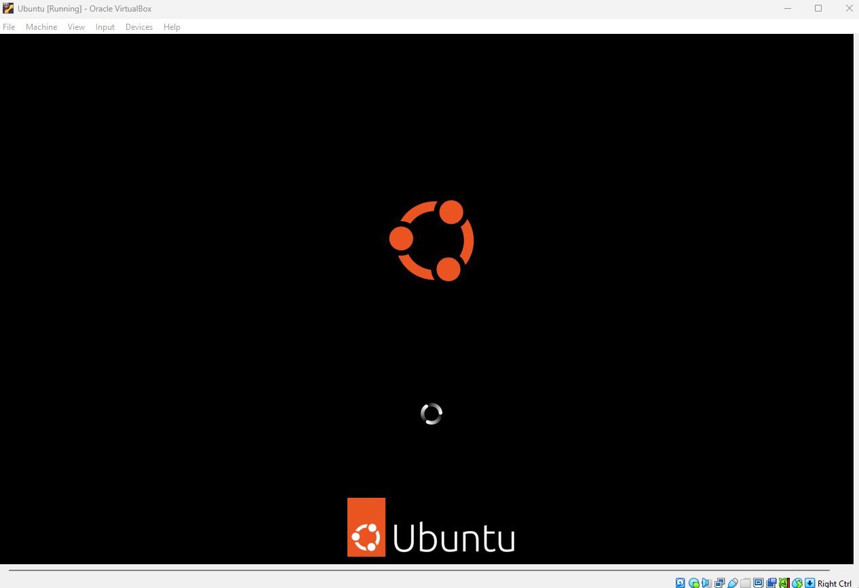
Ubuntu process running

Slide 7
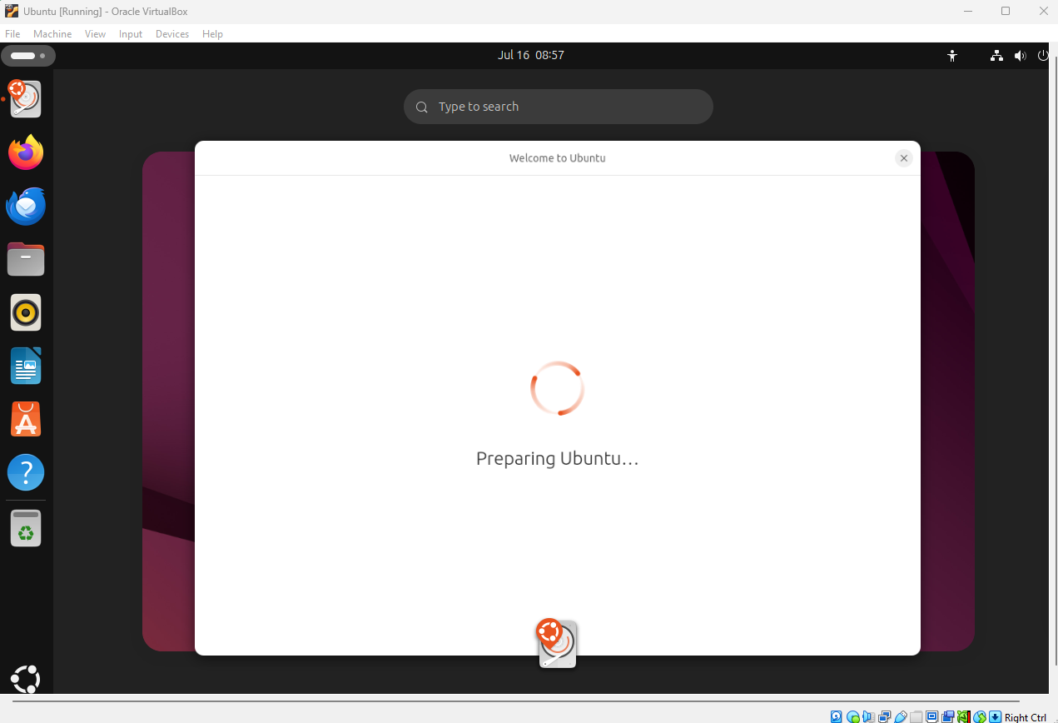

Slide 8
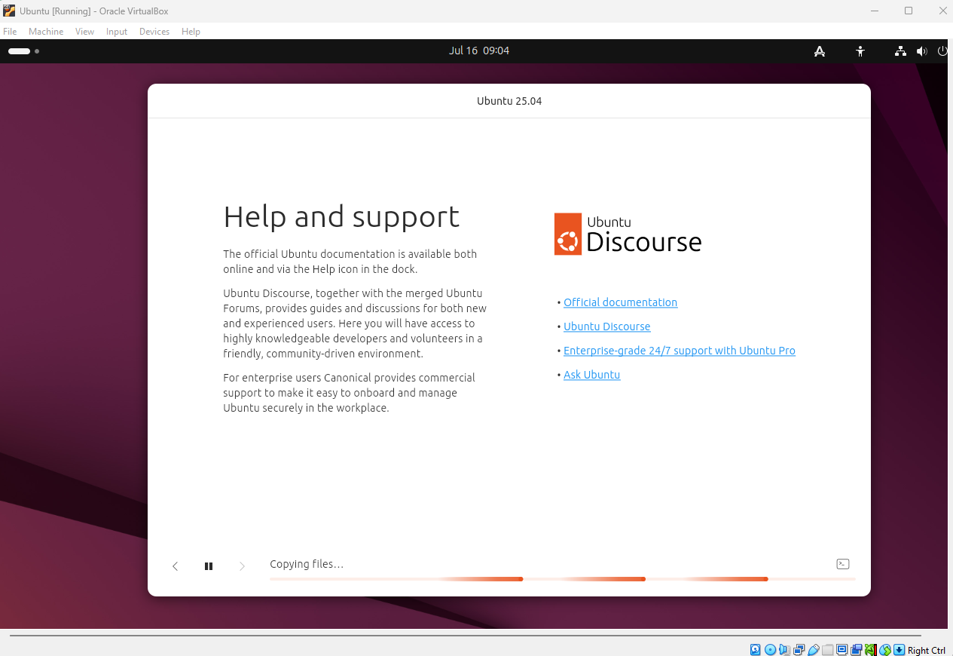

Slide 9
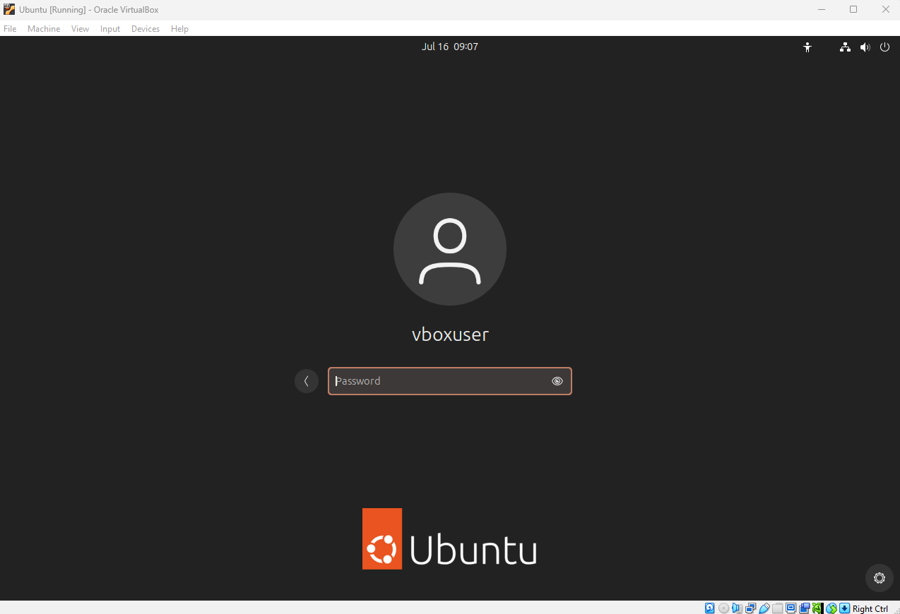
Ubuntu restarts after installation
Successful installation

Slide 10
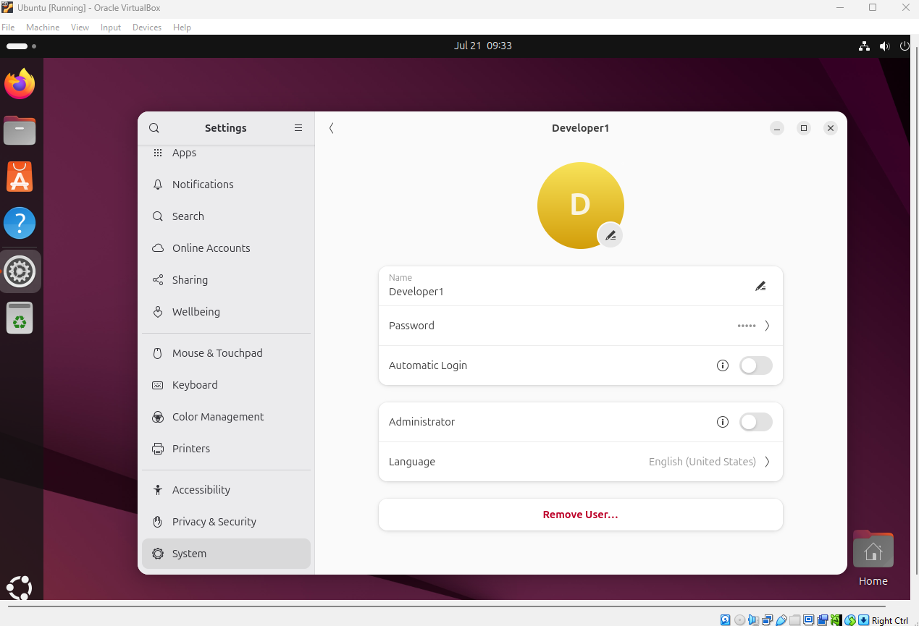
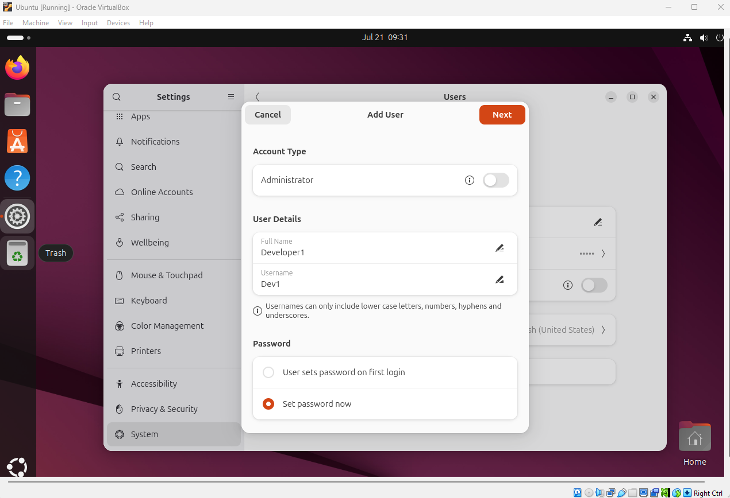
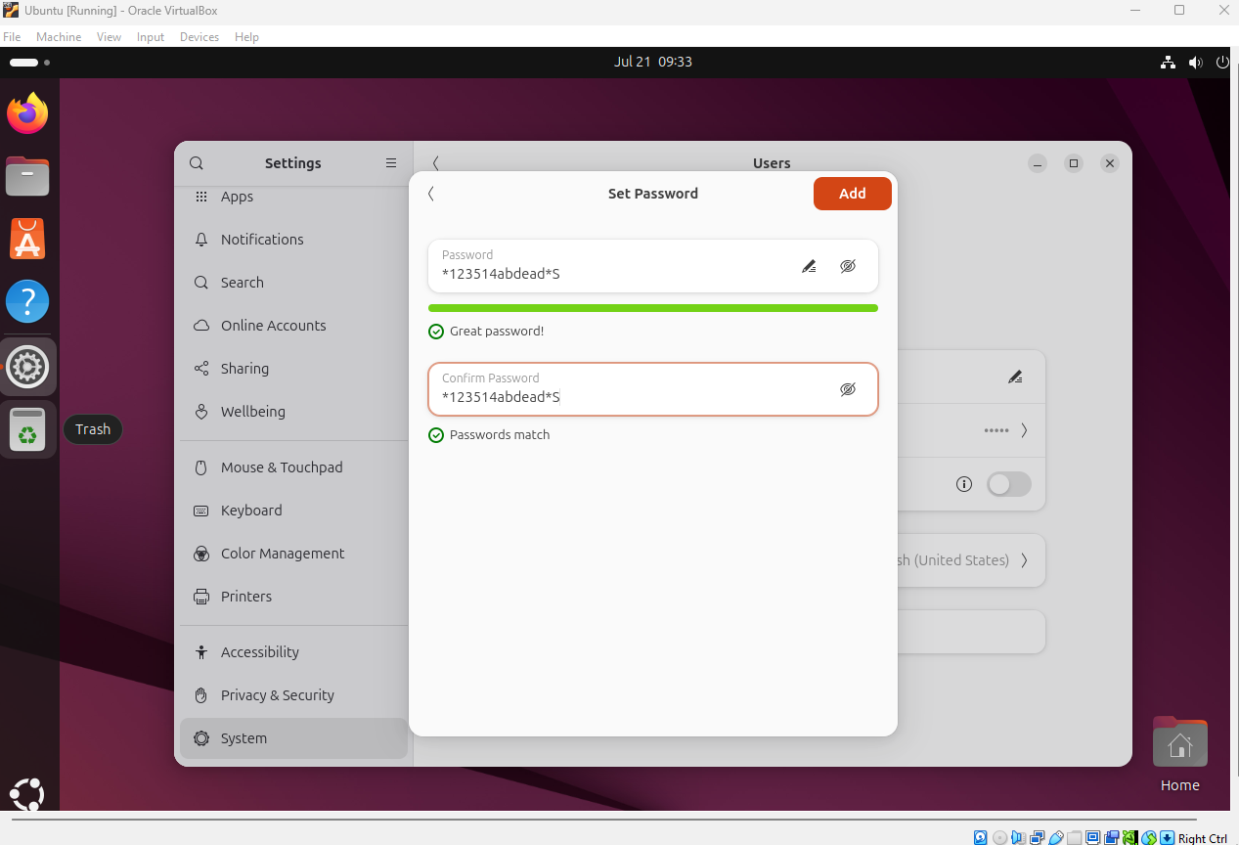
Account creation gui

Slide 11
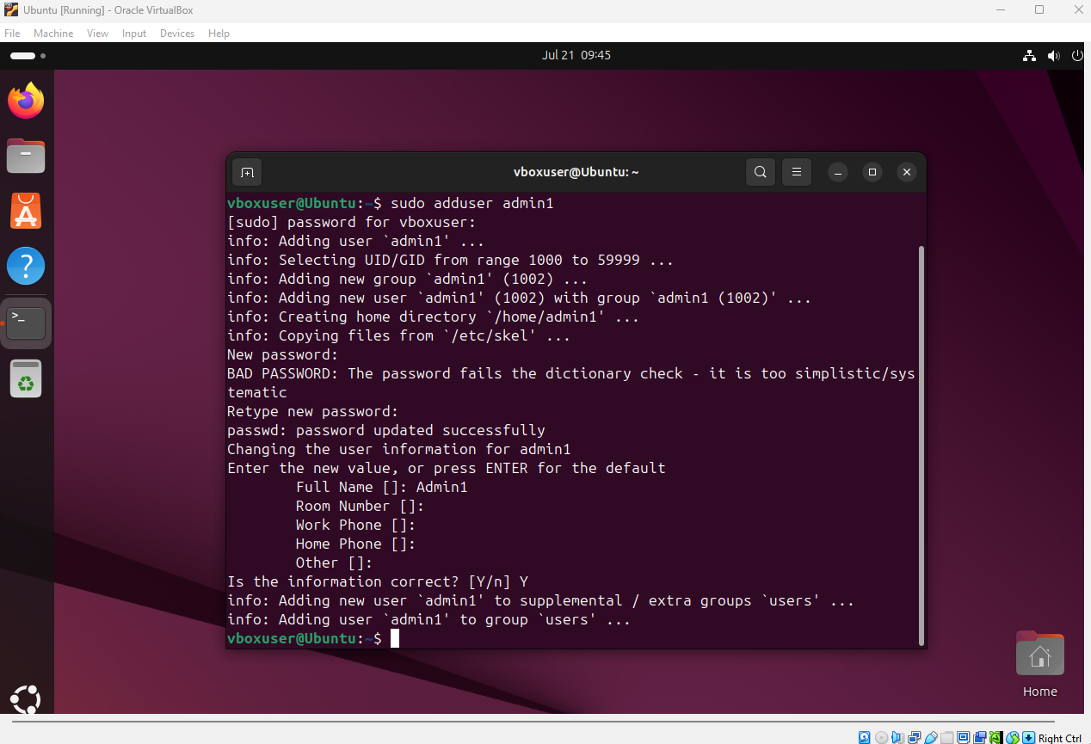
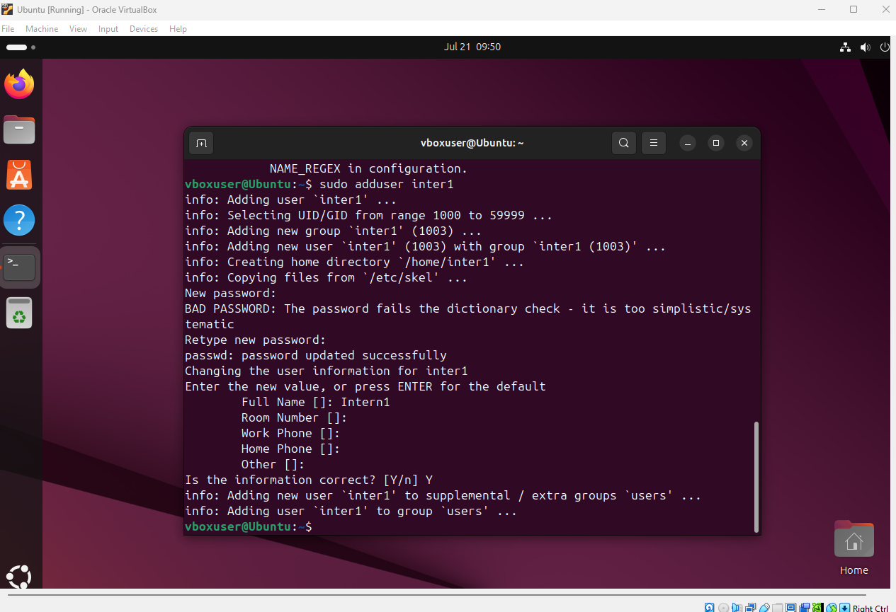
Account creation CLI

Slide 12
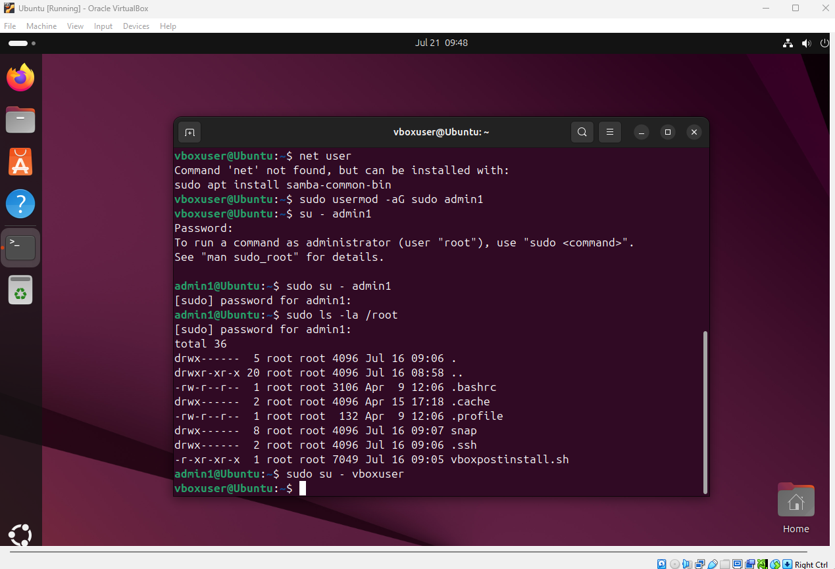
Give sudo privileges to new admin user account

Slide 13
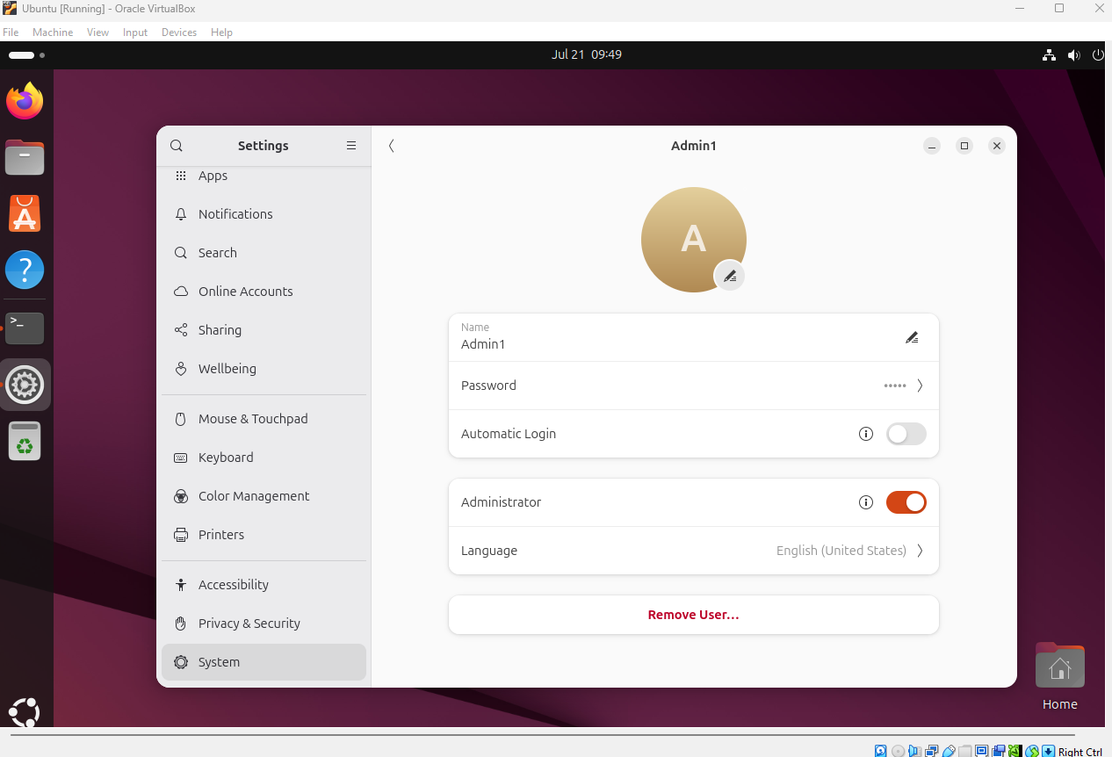

Slide 14
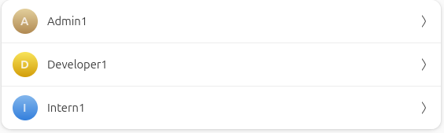

Slide 15
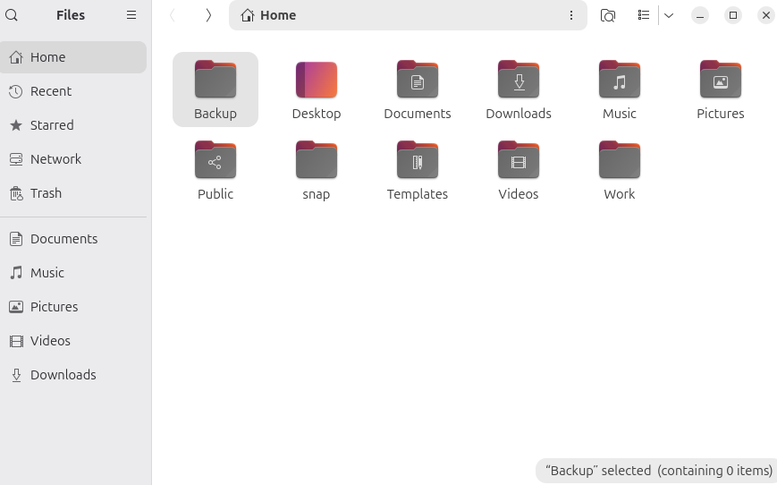
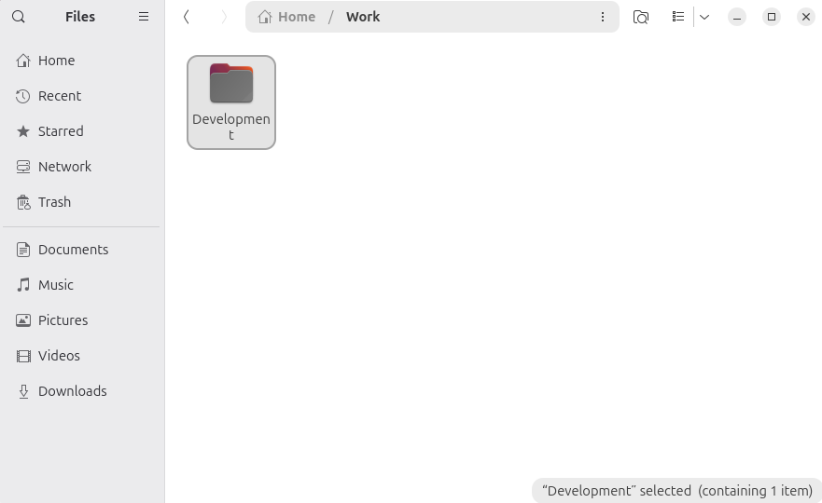
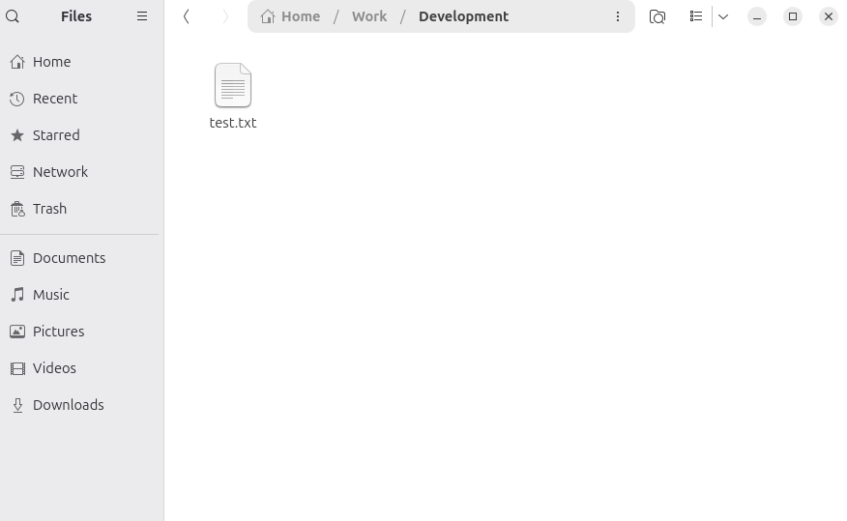

Slide 16
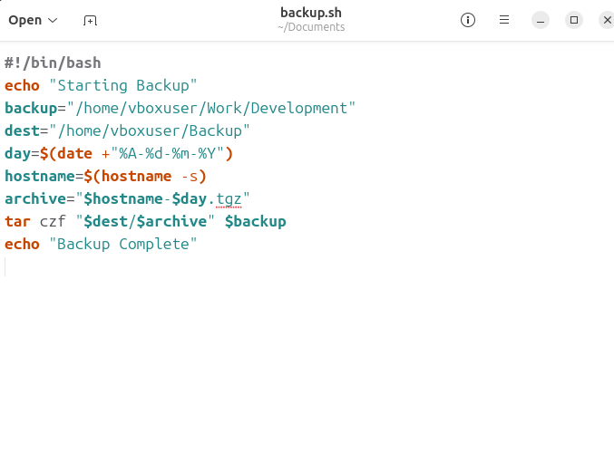
Echo repeats quoted text,
backup is the location that is getting backed up,
dest is the destination to send the backup,
day will display the date
Hostname will displays the system name
Archive results in the file having the system name as well as the date for easy identification from who/where and when the backup was done
Tar czf creates the backup

Slide 17
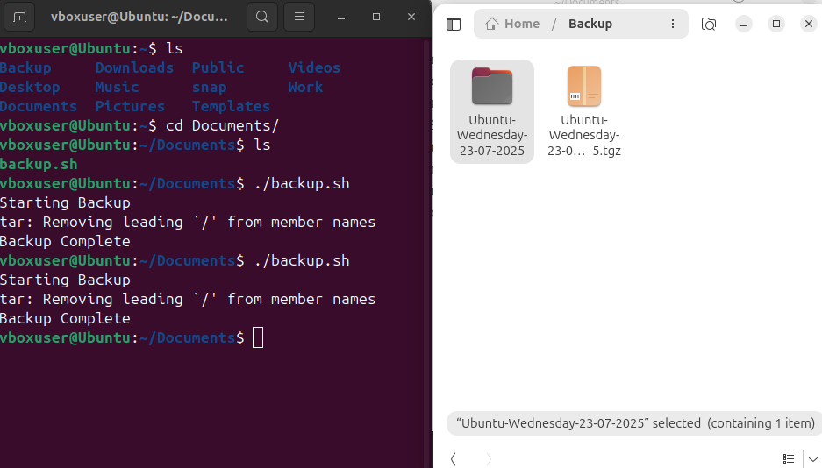
Tgz file contains the backup, tgz file can be used to hold backup to be kept safer and easily shared

